Slide 1
ASP.NET MVC
Les 1: Introduction

Slide 2
Introduction
ASP.NET MVC
Getting Started
Adding a Controller
Adding a View
Razor
HTML & TAG Helpers

Slide 3
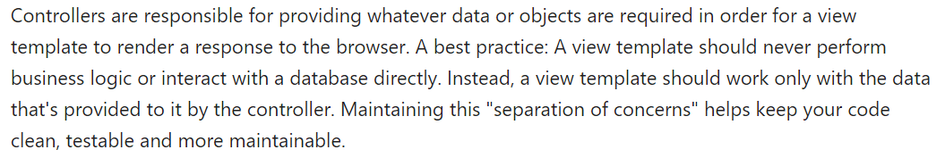
ASP.NET MVC
Separation Of Concerns

Slide 4
HoW?
Part 1: from scratch
Part 2: using templates
Without Bootstrap (focus on ASP.NET)
Writing Controllers/Views ourselves
Example: MvcMovie
Exercise: MotoGP
With Bootstrap
Scaffolding
Example: Contoso University
Exercise: Music Store

Slide 5
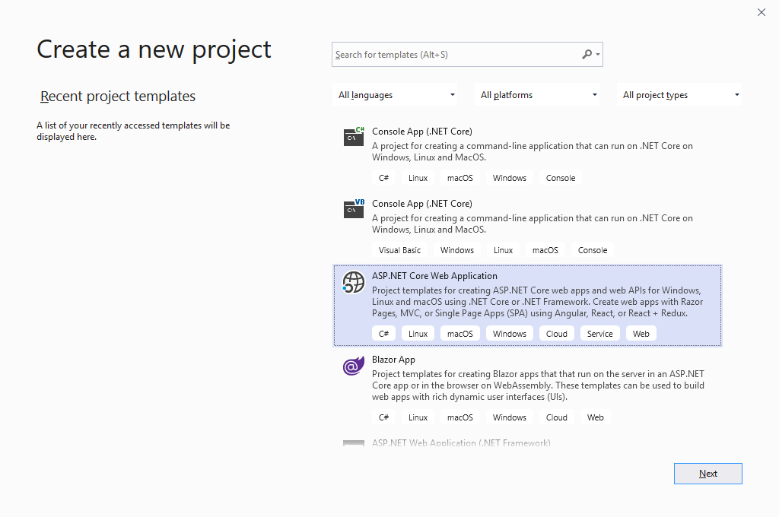
Getting started
Create a folder www (save all your webapplications in this folder)
Visual Studio
Create New Project
ASP.NET Core Web Application
Next

Slide 6
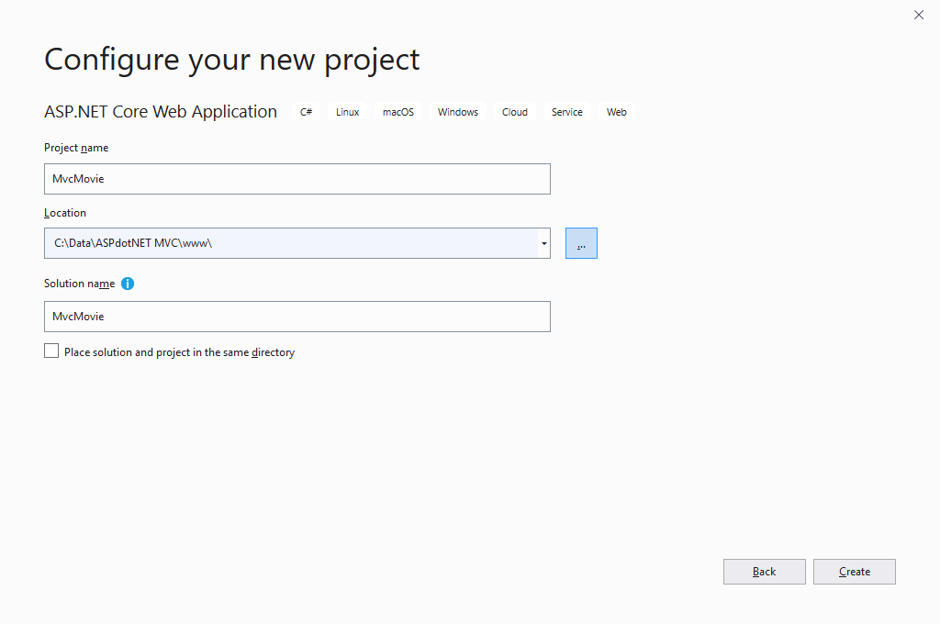
Getting started
MvcMovie
www folder
Create

Slide 7
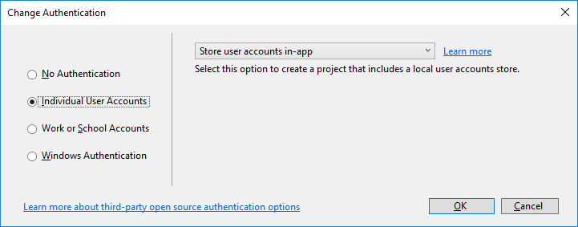
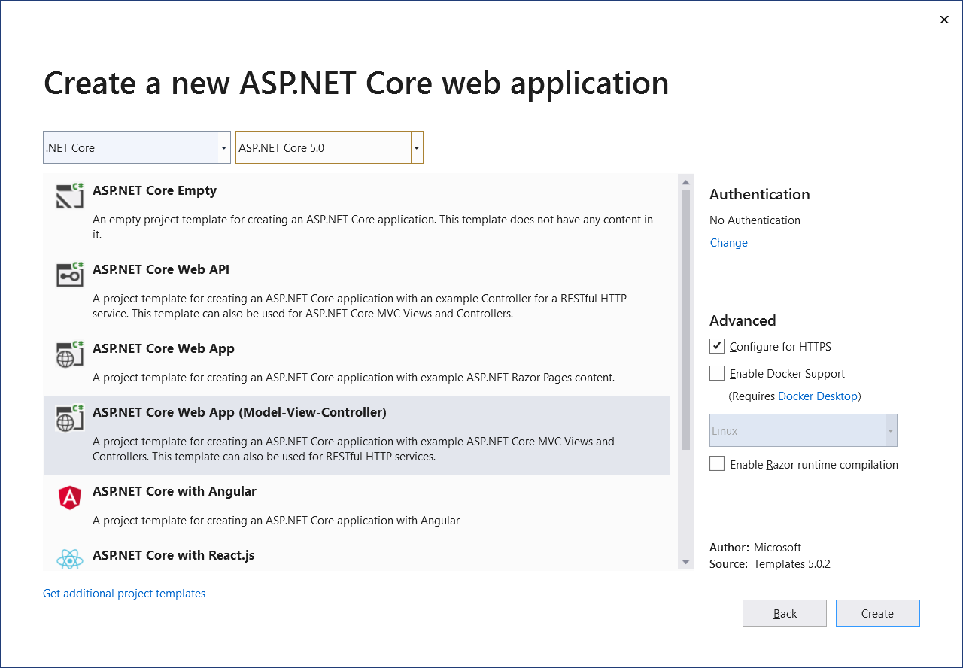
GETTING STARTED
ASP.NET Core 5.0
ASP.NET Core Web App (Model-View-Controller)
Authentication|Change
Indivual User Accounts|OK
Create

Slide 8
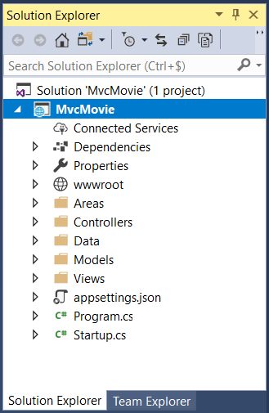
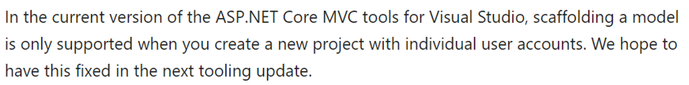
Getting started
The project also contains all the references to work with Entity Framework
For now, we do not use scaffolding and bootstrap, but develop everything from scratch

Slide 9
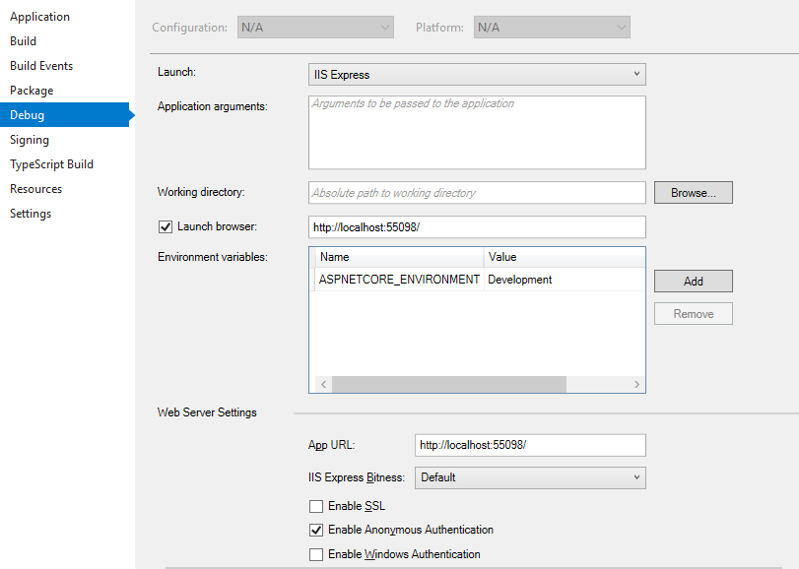
Disable SLL
Just use http instead of https during development (disable SSL)
MvcMovie | Right-click
| Properties | Debug

Slide 10
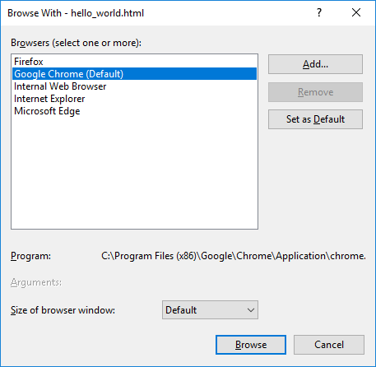
Default Browser
File|Browse With…
Chrome
Set as Default

Slide 11
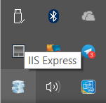
RunNING THE PROJECT
F5: debug-mode (start button)
You need to stop your application (top button) before you can make changes to your code
Ctrl-F5: non debug-mode (better for web development)
No need to stop the application for modifications, just save your code and refresh your browser to see the new version
Ctrl-F5:
Compilation of the project
Starting IIS Express
Calling the default controller and showing the result in the defaut browser

Slide 12
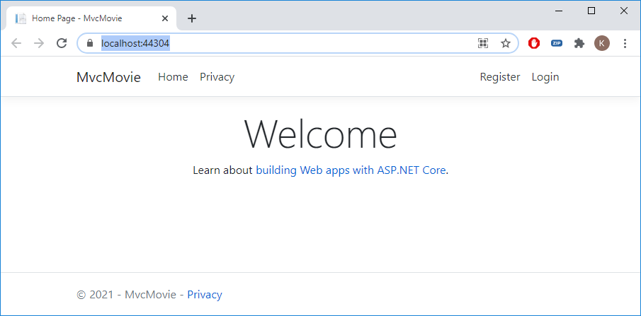
Running the project

Slide 13
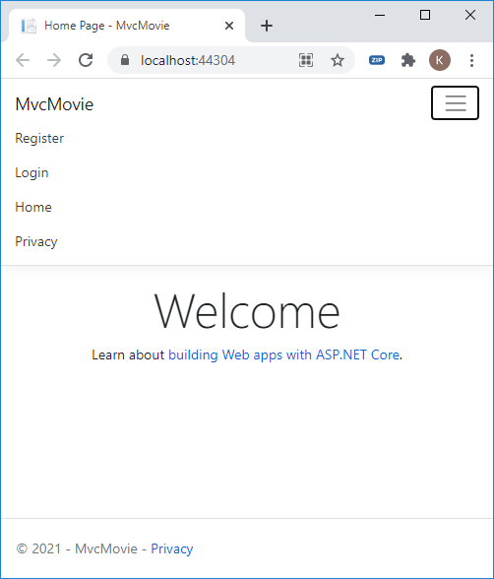
Bootstrap

Slide 14
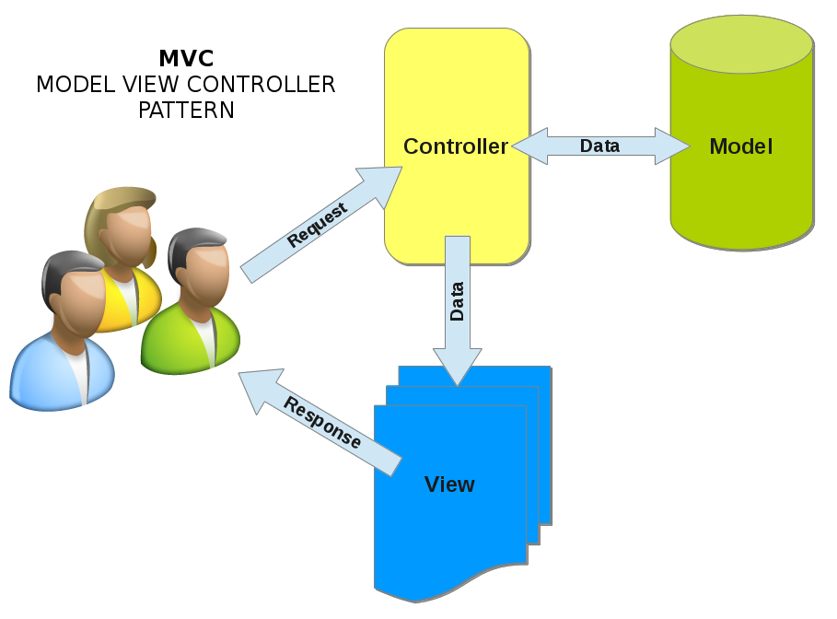
MVC

Slide 15

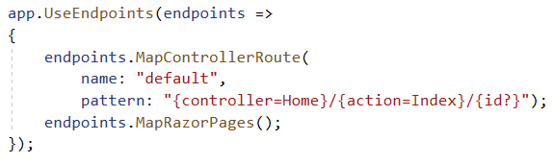
URL Segments
localhost:xxxx/Controller/Action
localhost:xxxx
localhost:xxxx/Home/Index
Startup.cs (default Controller, Action and first (default) parameter)

Slide 16
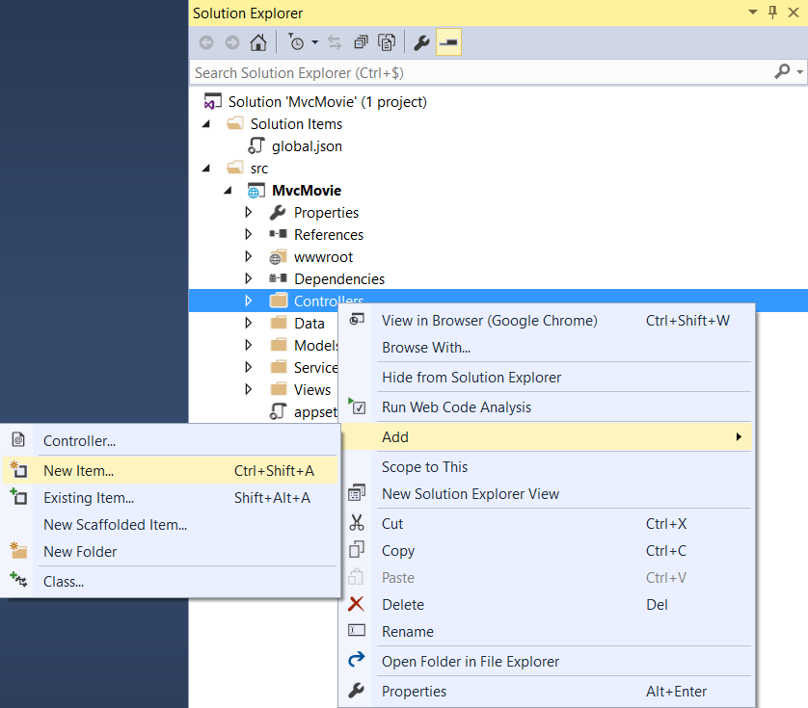
Adding a controller
Don't use scaffolding for now

Slide 17
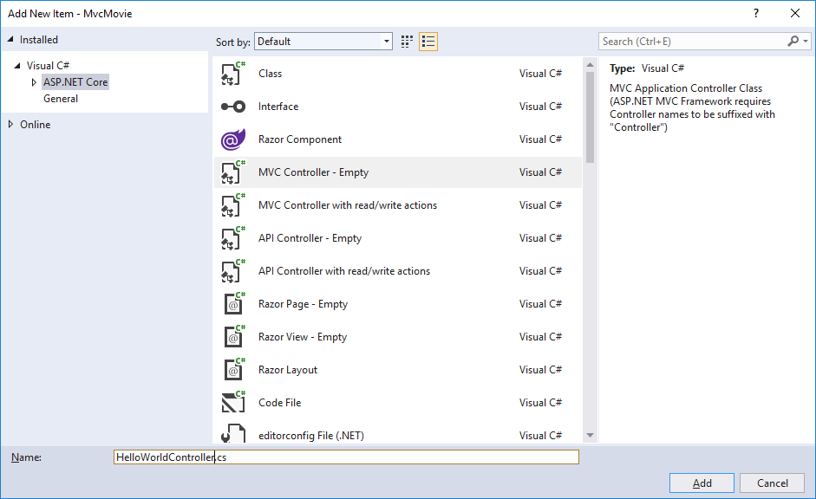
Adding a Controller ⬄ Class
HelloWorldController.cs

Slide 18
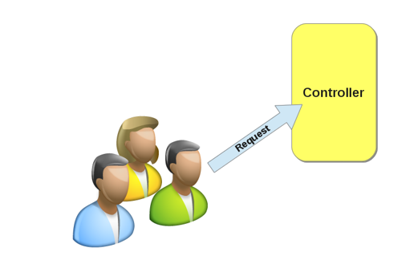
Class methods ⬄ Actions
namespace MvcMovie.Controllers
{
public class HelloWorldController : Controller
{
// GET: /HelloWorld/
public string Index()
{
return "This is my default action...";
}
// GET: /HelloWorld/Welcome
public string Welcome()
{
return "This is the welcome action method...";
}
}
}

Slide 19
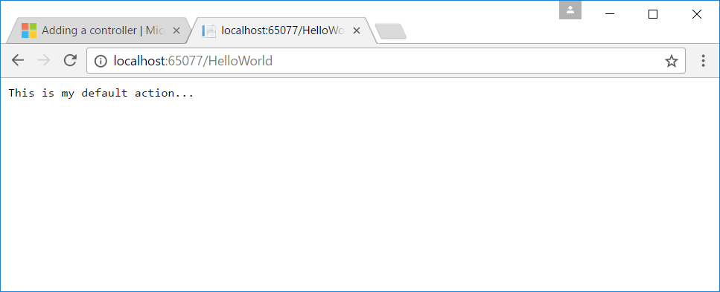
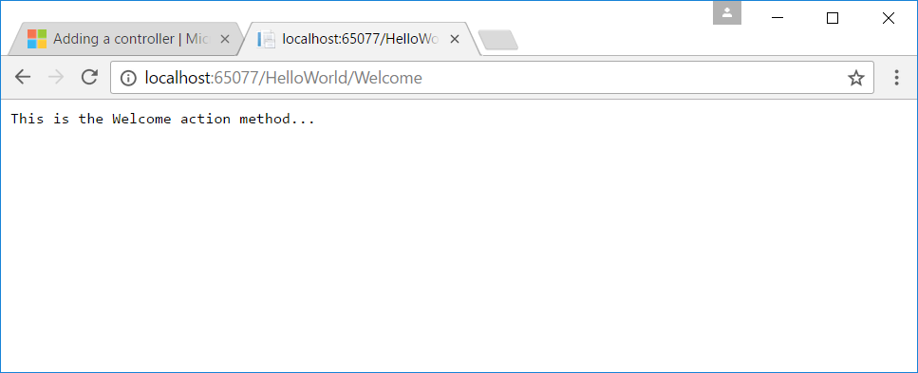
Class mapping
localhost:xxxx/HelloWorld
maps to
HelloWorldController Class

Slide 20
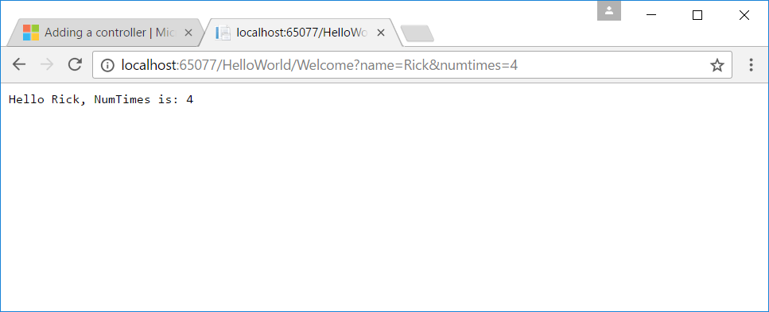
Parameters (1. query string ⇨ ?)
// GET: /HelloWorld/Welcome
public string Welcome(string name, int numTimes = 1)
{
return $"Hello {name}, NumTimes is: {numTimes}";
}

Slide 21
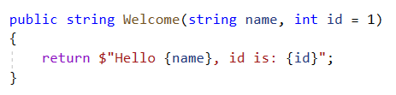
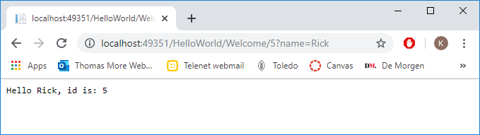
Parameters (2. url segment)

Slide 22
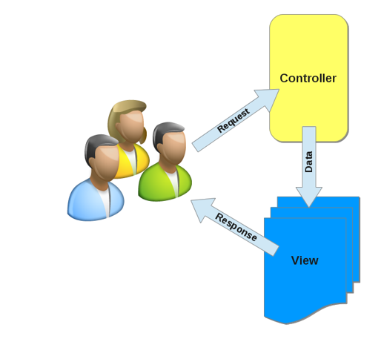
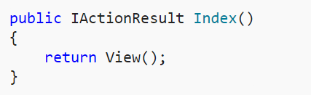
Adding a view
HelloWorldController.cs
Views folder | Add Folder | HelloWorld (controller name)
Helloworld | Add | New Item

Slide 23
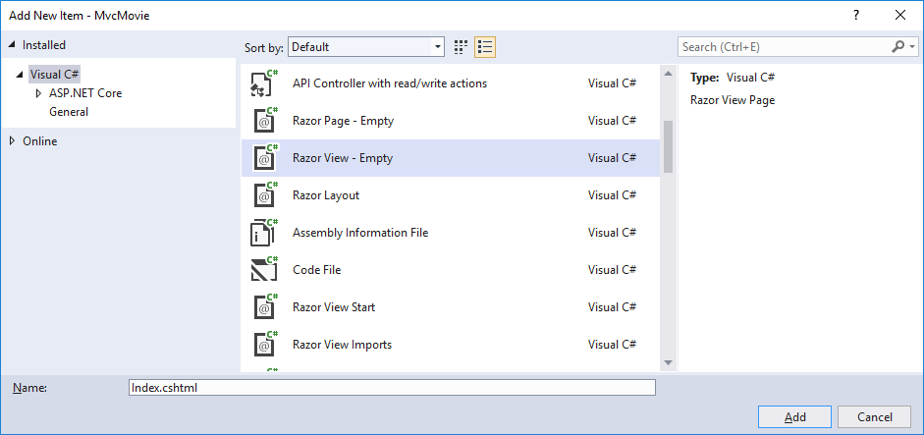
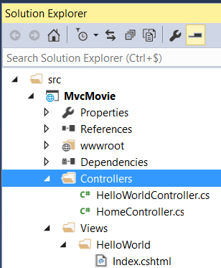
Adding a view
The name of the view = the name of the action from which the view is called

Slide 24
Adding a view
@{
ViewData["Title"] = "Index Title";
}
<h2>Index Header</h2>
<p>Hello from our Index View!</p>
ViewData is a Dictionary object that allows you to pass data between
Controller and View
View and View Template
Dictionary object contains a Key and a Value

Slide 25
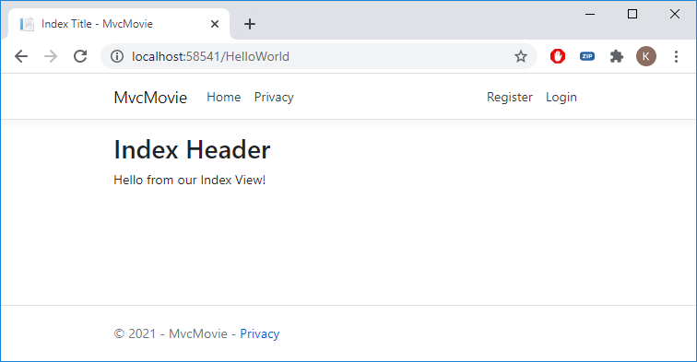
Adding a View
@{
ViewData["Title"] = "Index Title";
}
<h2>Index Header</h2>
<p>Hello from our Index View!</p>

Slide 26
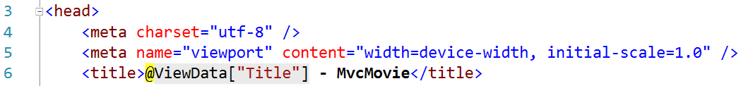
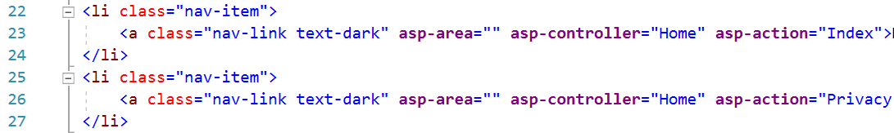
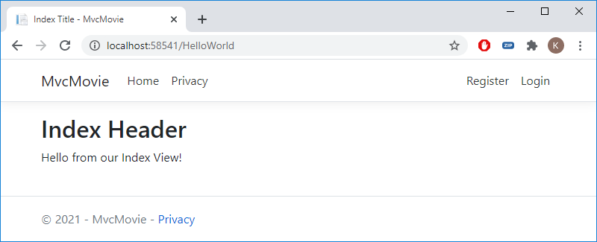
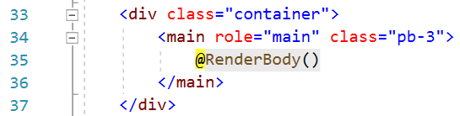
Layout Template
Views/Shared/_Layout.cshtml

Slide 27
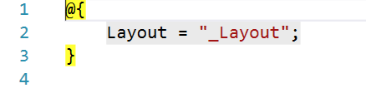
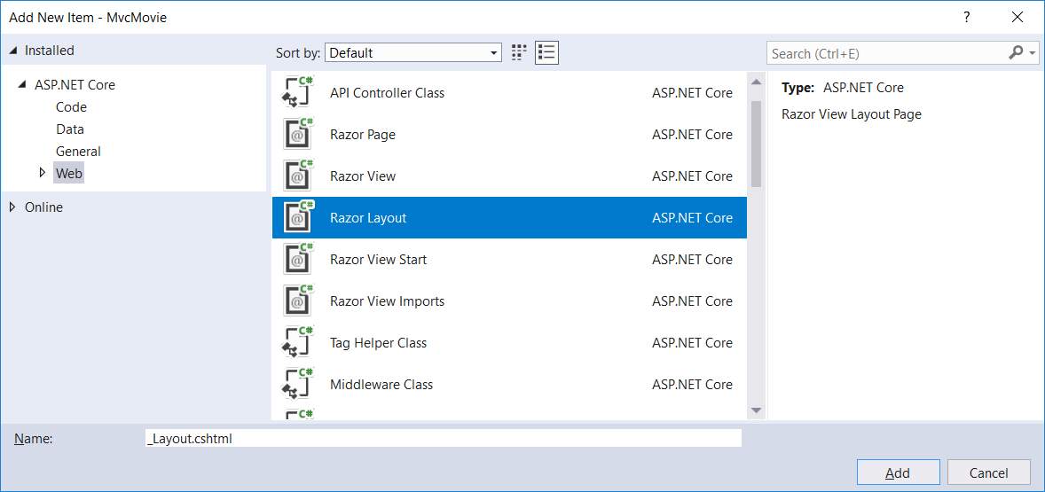
Setting the Layout Template
Views/_ViewStart.cshtml
Template without Bootstrap
Delete _Layout.cshtml
Shared | Add | New Item

Slide 28
Change the template (No Bootstrap for now)
<!DOCTYPE html>
<html>
<head>
<meta name="viewport" content="width=device-width" />
<title>@ViewData["Title"] - Mvc Movie</title>
</head>
<body>
<h1>Mvc Movie - @ViewData["Title"]</h1>
<div>
@RenderBody()
</div>
</body>
</html>

Slide 29
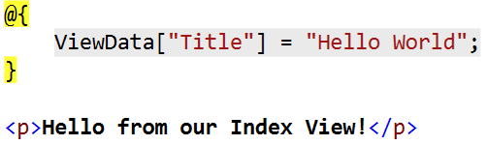
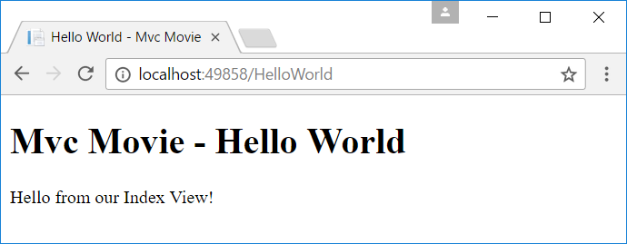
Change the view
<!DOCTYPE html>
<html>
<head>
<meta name="viewport" content="width=device-width" />
<title>@ViewData["Title"] - Mvc Movie</title>
</head>
<body>
<h1>Mvc Movie - @ViewData["Title"]</h1>
<div>
@RenderBody()
</div>
</body>
</html>
Index.shtml

Slide 30
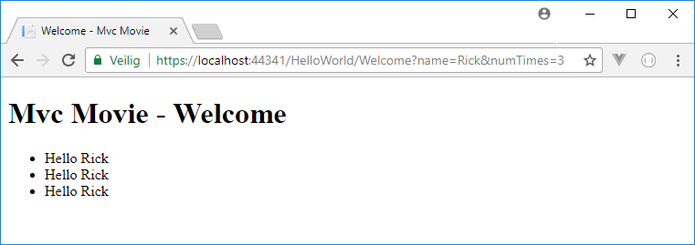
Passing data from the controller to View
HelloWorldController
Extra Razor View Welcome.cshtml
public IActionResult Welcome(string name, int numTimes = 1)
{
ViewData["Message"] = "Hello " + name;
ViewData["NumTimes"] = numTimes;
return View();
}
@{
ViewData["Title"] = "Welcome";
}
<ul>
@for (int i = 0; i < (int)ViewData["NumTimes"]; i++)
{
<li>@ViewData["Message"]</li>
}
</ul>

Slide 31
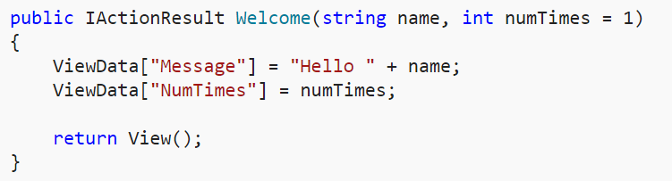
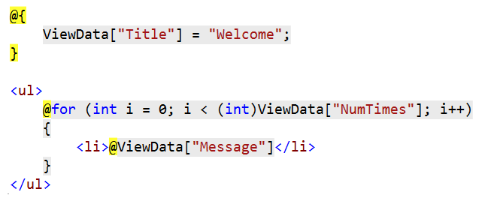
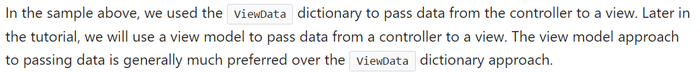
Passing Data from Controller to View

Slide 32
ASP.NET Razor Views
.cshtml
A Razor View Page contains
Html <html>
Razor @{ var name = "Jeff"; }
HTML helpers @Html.ActionLink("Movies", "List", "Movies")
TAG helpers <a asp-controller="Movies" asp-action="List">Movies</a>

Slide 33
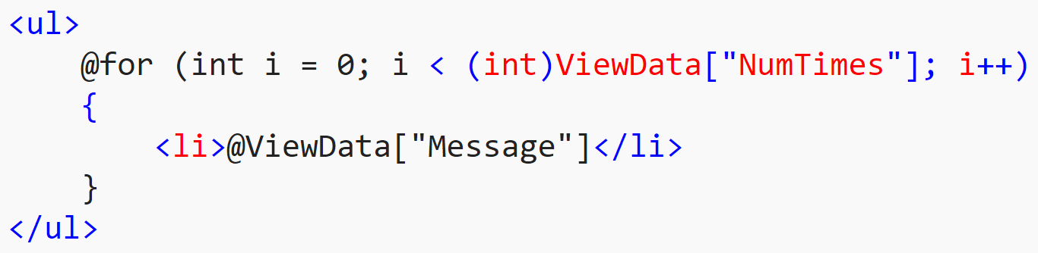
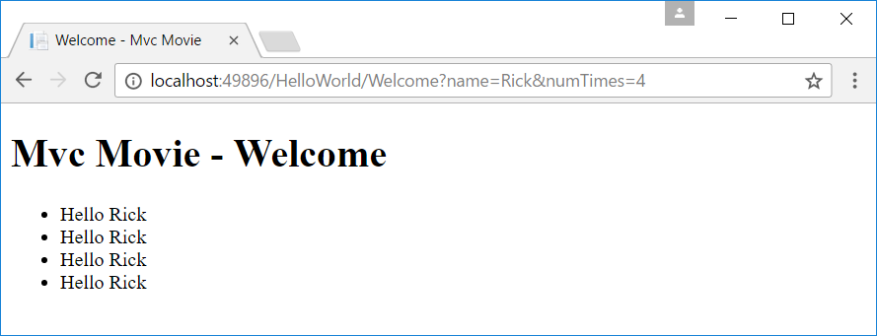
@Razor

Slide 34
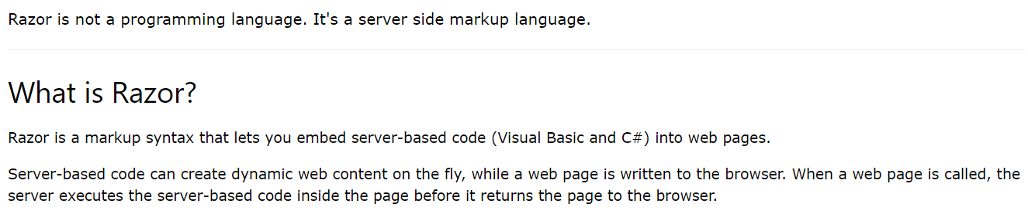
What is razor?

Slide 35
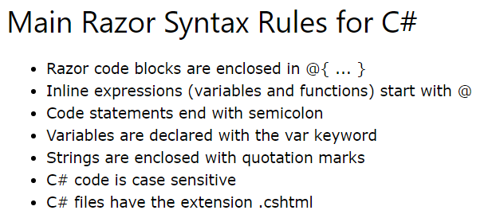
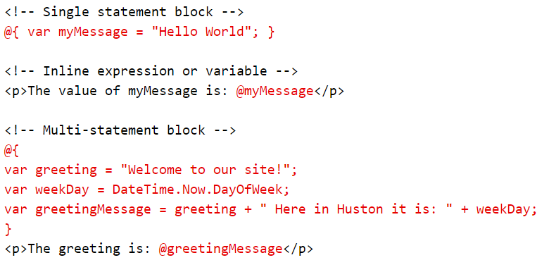
Razor Syntax

Slide 36
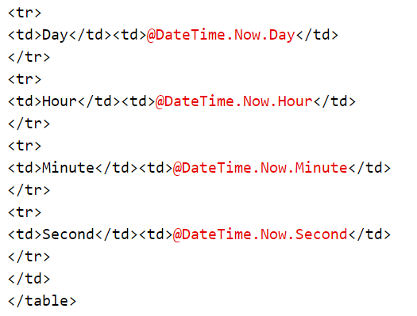
Razor Expressions: @( expression )

Slide 37
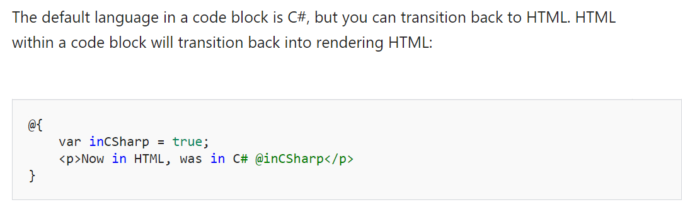
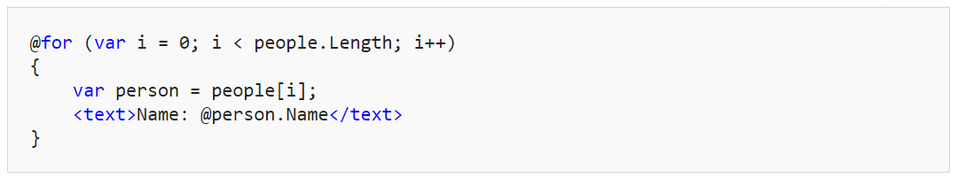
transitions

Slide 38
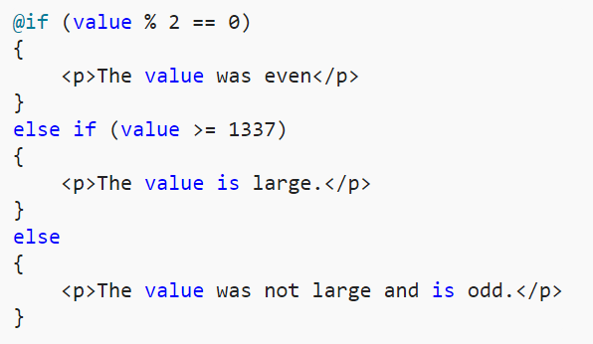
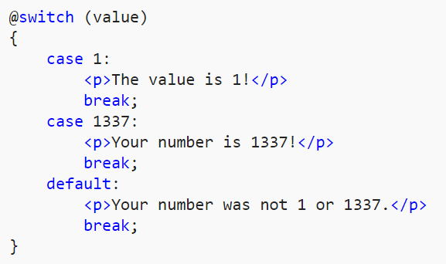
Control structures

Slide 39
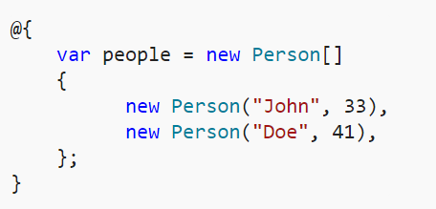


Looping

Slide 40
HTML & TAG Helpers
HTML Helper
@Html.ActionLink("Movies", "List", "Movies")
TagHelper
<a asp-controller="Movies" asp-action="List">Movies</a>
Output in browser
<a href="/Movies/List">Movies</a>
Notes:
Html helper
@Html.ActionLink(“Back to index”,”Index”,”HelloWorld”);
Taghelper
<a asp-controller=“Helloworld” asp-action=“Welcome” asp-route-name=“Sharon” asp-route-NumTimes=a>To the welcome page</a>

Slide 41
URL Helper (to be used in the exercise)
@Html.ActionLink("Movies", "List", "Movies")
⇨Output in browser
<a href="/Movies/List">Movies</a>
@Url.Action("Movies", "Detail", new { id = 6 })
⇨ Output in browser
/Movies/Detail/6

Slide 42


MVCMOvie Main Menu: Home/Index.cshtml
@{
ViewData["Title"] = "Main Menu";
}
<h2>Lesson 1: Introduction</h2>
<a asp-controller="HelloWorld" asp-action="Index">Hello World</a><br />
<a asp-controller="HelloWorld" asp-action="Welcome"
asp-route-name="Rick" asp-route-numTimes="5">Welcome</a><br />

Slide 43

HTML & Tag Helpers (more to come)

Slide 44
Exercise
MotoGP Part 1

